Slide 1

Mythri Gali
Final Project
VADISETTI UMA VENKATESH
3/21/2024 Annual Review

Slide 2

PROJECT TITLE KEYLOGGER AND SECURITY
3/21/2024 Annual Review

Slide 3


AGENDA * Introduction * Problem Statement * Project Overview * Who Are The End Users * Solution and Value Proposition * The “Wow” factor in our Solution * Modelling * Results
3/21/2024 Annual Review

Slide 4

PROBLEM STATEMENT: The objective of this project is to develop a keylogger software with enhanced security features to prevent unauthorized access to sensitive data and ensure user privacy. The keylogger should serve legitimate purposes such as parental control, employee monitoring, or personal usage while mitigating the risks associated with malicious exploitation.
3/21/2024 Annual Review

Slide 5

PROJECT OVERVIEW Develop a comprehensive understanding of keyloggers, their types, how they work, and effective security measures to prevent keylogging attacks.
3/21/2024 Annual Review

Slide 6

WHO ARE THE END USERS? * IT and Security Professionals: Cybersecurity Analysts ,Network Administrators. * Organizations and Businesses: IT Departments, Compliance Teams. * Software Developers: Application Developers, Security Engineers. * Educational Institutions: Students and Researchers, Professors and Instructors. * Government And Law Enforcement Agencies: Policy Makers. * Ethical Hackers: Security Researches, Bug Bounty Hunters.
3/21/2024 Annual Review

Slide 7

YOUR SOLUTION AND ITS VALUE PROPOSITION 1.Anti-Key-logger – As the name suggest these are the software which are anti / against key loggers and main task is to detect key-logger from a computer system. 2.Anti-Virus – Many anti-virus software also detect key loggers and delete them from the computer system. These are software anti-software so these can not get rid from the hardware key-loggers. 3.Automatic form filler – This technique can be used by the user to not fill forms on regular bases instead use automatic form filler which will give a shield against key- loggers as keys will not be pressed . 4.One-Time-Passwords – Using OTP’s as password may be safe as every time we login we have to use a new password. 5.Patterns or mouse-recognition – On android devices used pattern as a password of applications and on PC use mouse recognition, mouse program uses mouse gestures instead of stylus. 6.Voice to Text Converter – This software helps to prevent Keylogging which targets a specific part of our keyboard.
3/21/2024 Annual Review

Slide 8

THE WOW IN YOUR SOLUTION > AI-Powered Detection: Utilizes artificial intelligence and machine learning to continuously improve detection accuracy and adapt to new threats > Cloud Integration: Offers cloud-based threat analysis and updates , ensuring users are protected against the latest threats without manual intervention. > Comprehensive Reports: Generates detailed security reports and analytics , providing users with insights into attempted attacks and overall system health. > Customizable Alerts: Allows users to set custom alert thresholds and notifications, tailoring the security experience to their specific needs.
3/21/2024 Annual Review
8

Slide 9
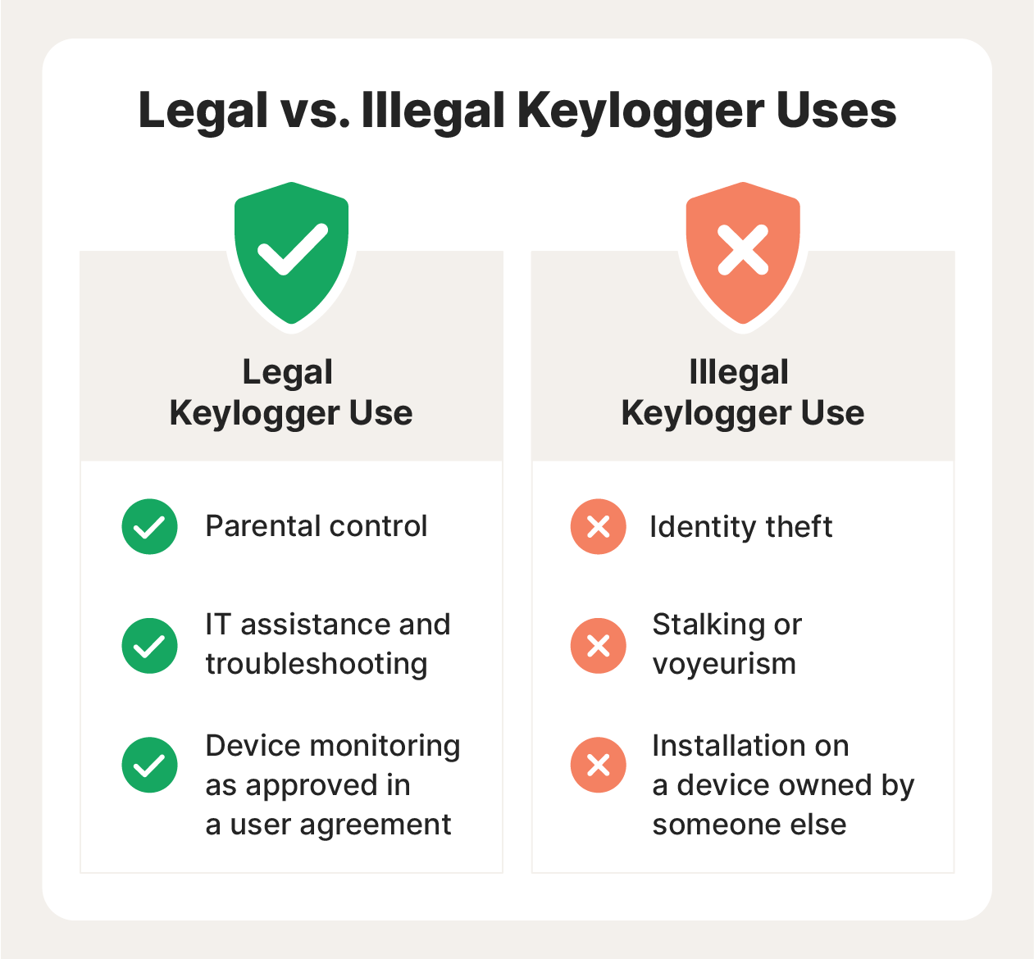
MODELLING
Innovative Approach: Combining technical measures with user education for comprehensive protection.
Demonstration: Real-time demonstration of a simple keylogger to illustrate the threat and the effectiveness of security measures.
Impact: Significant reduction in the likelihood of keylogging attacks through proactive measures.
3/21/2024 Annual Review
9

Slide 10
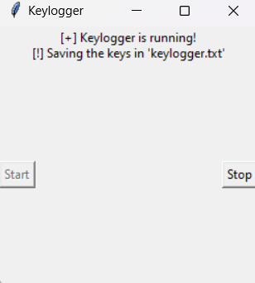
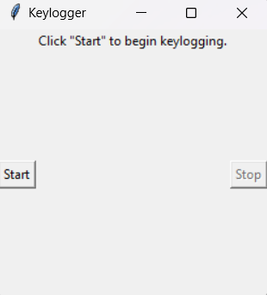
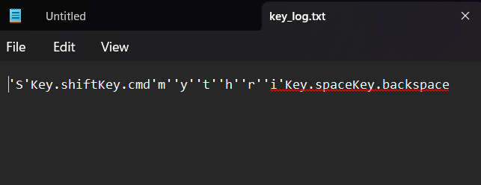
RESULTS Successfully implemented a keylogger that captures keystrokes and records them into both text and JSON files. Real-time keylogging with start and atop functionality controlled via a simple GUI. The Keylogger project demonstrated the capability to effectively capture and log ketstrokes in real- time. The GUI provided a user-friendly way to control the keylogger, making it accessible and easy to use. Emphasized the ethical use of keyloggers and the importance of implementing security measures to protect against malicious use.
3/21/2024 Annual Review
10

Slide 11
Project link
https://github.com/UmaVenkateshVadisetti/venky.git

